Slide 1

Prescription recognizer
Presenters:
Laya k
Sanju shree T N
Abinaya G M
Olivea Tresa S

Slide 2

Bridging the Communication Gap: Improving Prescription Understanding and converting it as a Electronic Health Record
Understanding human-written language can be challenging, especially in the medical field.
Pharmacists often struggle to interpret doctors' prescriptions, which can lead to medication errors and harm patients.
By digitalizing prescriptions we can maintain consistant patient record in the hospital and helps to gothrough the history.

Slide 3
Idea and approach
Step 1: Set Up Your Azure Environment:
Create a new resource group to organize your resources.
Create a Document Intelligence resource within your resource group.
Step 2: Prepare Your Data:
Gather a collection of handwritten prescription images.
Divide the images into two sets:
Training data: Used to teach the model how to recognize text and extract information.
Test data: Used to evaluate the model's accuracy.
Step 3: Train a Custom Model:
Use the Document Intelligence Studio to create a new custom model project.
Upload your training data to the studio.
Train the model to recognize text and extract relevant information from the prescriptions.
Test the model's performance on the test data.
Step 4: Deploy Your Model:
Deploy the trained model to your Document Intelligence resource.

Slide 4
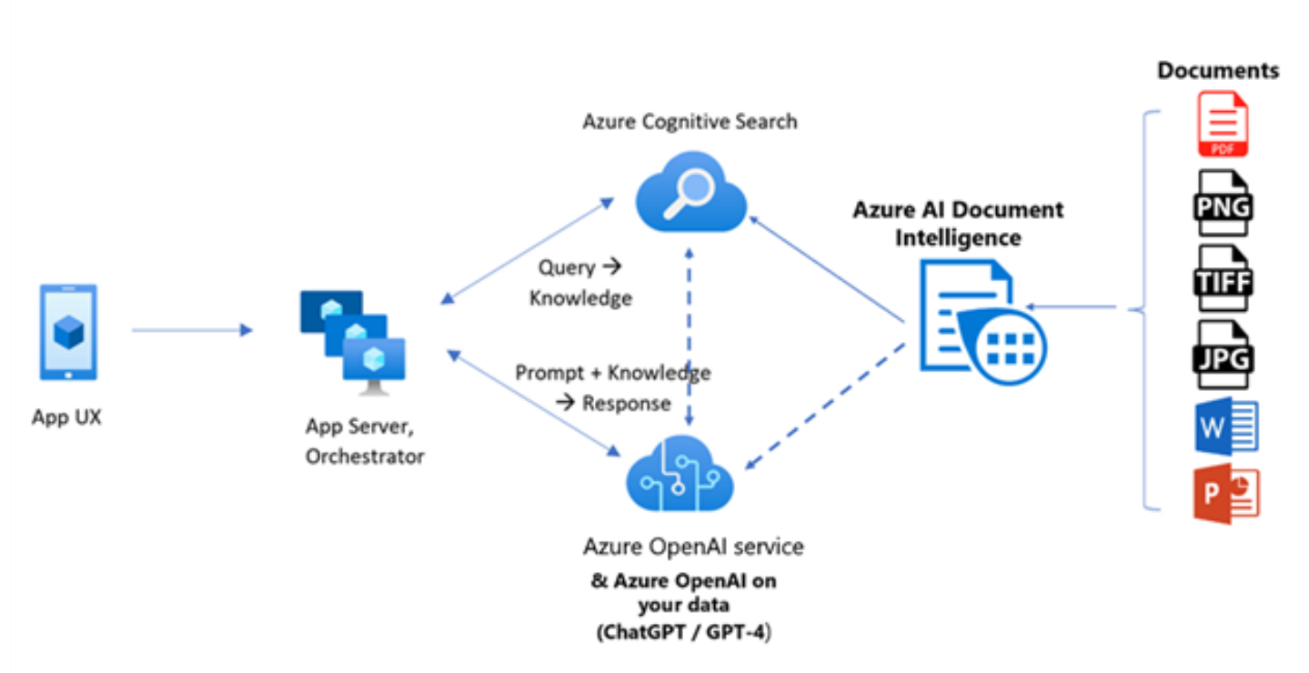
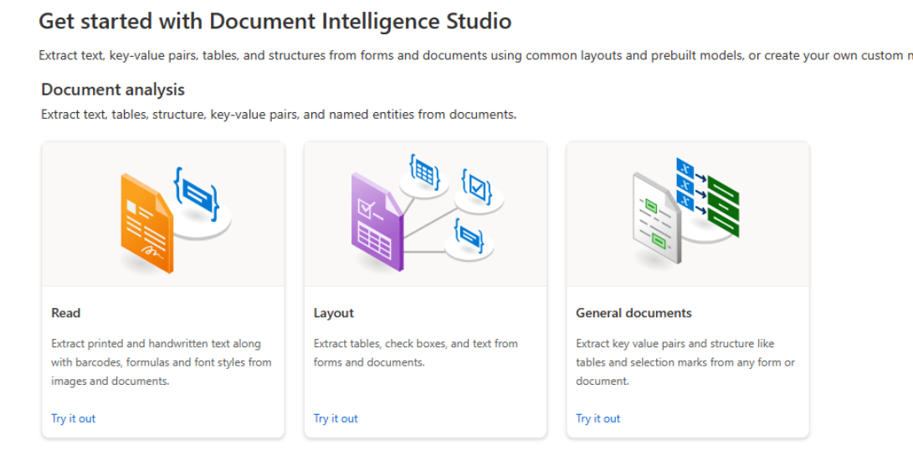
Reduced Miscommunication
Clear Communication: Reduces the risk of errors caused by illegible handwriting or ambiguous terminology.
Faster Processing: Automates the time-consuming task of manually entering prescription details, speeding up the overall process.
Data-Driven Insights:
Data Analysis: Collects and analyzes prescription data to identify trends and patterns.
Informed Decision-Making: Supports data-driven decision-making for optimizing medication management.

Slide 5


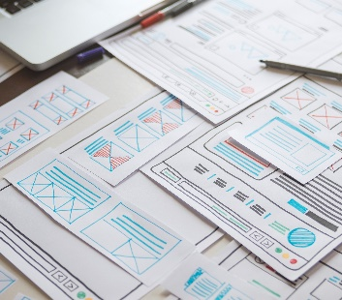
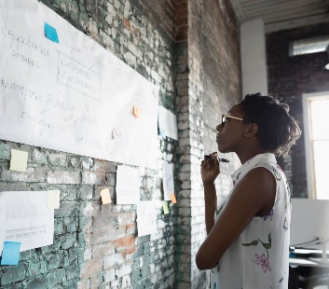
Thank you

